Slide 1

Text Classification Competition – Attention-based Transformers
CS410: Text Information System
Team: Fan & Jain Rhymes -
Wenxi Fan (NetID: wenxif2; Email:wenxif2@illinois.edu)
Abhishek Jain (NetID: aj26; Email:aj26@illinois.edu)

Slide 2
Agenda:
Project Goal and Our Approach
Code Walkthrough
Run the Code Test
Our Results

Slide 3

Project Goal
Project Goal: Implement text classifier to be able to identify if the twit is sarcasm or not.
Inputs: text (tweets) –
Response : the tweet response to be classified
Context : the conversation context of the response
Labels: SARCASM or NOT_SARCASM (two classes)
Goal: text classifier implemented to achieve f1 score >70%
Motivation:
Research, learn and implement best-in-class next generation techniques to approach text-based classification problems.
Expand our knowledge & understanding in NLP space beyond what is taught in the course.

Slide 4

Approach - Overview
Research
Goal
Research available best-in-class NLP techniques
Learn & understand the application of each techniques
Outcome
Attention-based Approach to Text Classification
https://github.com/Wenfan1993/CourseProject/blob/main/Research_Summary/AttentionBased%20Approach%20to%20Text%20Classification.pdf
The Application of Attention Models in Text Classification
https://github.com/Wenfan1993/CourseProject/blob/main/Research_Summary/Application%20of%20Attention%20to%20Classification.pdf
Experiment
Goal
Evaluate different NLP techniques & short list for final implementation
Outcome
Initial experiments conducted for baseline results
TFIDF/SVM
Bi-directional LSTM with embedding
Transformer based Pre-Trained Model)
Improvise
Goal
Optimize the best technique researched & tune it for result generation.
Outcome
Transformer based implementation were finalized
Tuned with different input structures
Used different pre-trained models like Bert, Roberta, XLM etc.

Slide 5
Approach - Research
Research Focus:
Attention Mechanism, a breakthrough principle which has revolutionized building state-of-the-art NLP solutions. Detailed overview on different solution architectures styles which can be used to solve text classification problem.
See below reference to our research documents:
https://github.com/Wenfan1993/CourseProject/blob/main/Research_Summary/AttentionBased%20Approach%20to%20Text%20Classification.pdf
https://github.com/Wenfan1993/CourseProject/blob/main/Research_Summary/Application%20of%20Attention%20to%20Classification.pdf

Slide 6
Approach - Experiment
Conventional ML
Overview
Deep Learning & Attentions
Overview
Bi-Directional LSTMs
Pre-Trained Transformers
Overview
BERT fine tuned.
TF-IDF based vector representation
Results
Results
Under performer
Better than conventional ML.
Results
Both BERT and RoBERTa outperformed baseline.
SVM based classifier
Not close to baseline
Embedding layer
Self-Attention multi head
Improvement with embeddings
Near baseline.
RoBERTa fine tuned.
RoBERTa performance better than BERT.

Slide 7
Approach – Improvise (1)
Feature Engineering & Problem Structuring
Input sequence structured as:
Single Document Classification
All tweets combined as single document for classification
Response and Last tweet combined as single document for classification
Sequence Classification
Tweets modeled as two text sequence for classification
Response, Last Tweet
Response, Context
Response, Context reversed
Best results observed when problem modelled as Sequence Classification setup with text sequence as Response and Context reversed.

Slide 8
Approach – Improvise (2)
BERT and RoBERTa
BERT Model - Bidirectional Encoder Representations from Transformer
Designed to pretrain deep bidirectional representations from unlabeled text by jointly conditioning on both left and right context in all layers;
Has certain limitations, e.g. BERT is limited to a particular input length for long
document is split into segments of a fixed size with overlap.
RoBERTa – Robustly optimized BERT approach
RoBERTa is the enhanced transformer based on BERT approach
RoBERTa is trained with dynamic masking, FULL-SENTENCES without NSPloss, large mini-batches, and a larger byte-level BPE. ⁽²⁾
RoBERTa overcomes several limitations of BERT including the one mentioned above.

Slide 9
Approach – Improvise (3)
Model Overview
Roberta Embeddings:
Word embeddings
Position embeddings
Token-type embeddings
Roberta Encoder (12 Roberta Layers)
Each layer includes:
Roberta Self-attention based on query, key, value
Roberta Self-output with dense layer, layer norm and dropout
Roberta Intermediate with dense/linear layer
Roberta Classifier: with dense/liner layers
For more information, please refer to reference (1)

Slide 10
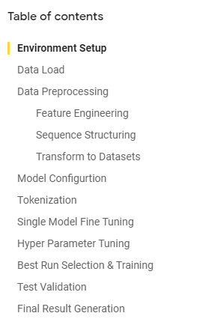

Code Walk-through
Steps:
Environment Setup (Transformers model installation, Hyper-parameter tuning Library installation, Colab set-up)
Data load and preprocessing
Features:
we explored using the response, latest context, response and latest context concatenated, context reversed, and the combination of such, and turns out using the below features gave the best performance
Response
Context reversed (starting from latest dialog)
Label: 1 for SARCASM; 0 for Non-SARCASM
Model Configuration
Choose roberta-base model
Set up the evaluation metrics, batch-size, train-test split ratio, number of epochs
Tokenization
Use API AutoTokenizer
Single model finetuning
Set AutoModelForSequenceClassification, TrainingArguments wrapped in Trainer object
Hyperparameter tuning
Use hyperparameter_search method of the trainer object
Selected the best run
Select the best hyper-parameter that maximize the metrics (accuracy)
Test and compute the accuracy, precision, recall and f1 of the best model
Generate the outputs for submission
See Colab file ‘SequenceClassifier.ipynb’ for the script that includes these steps
https://colab.research.google.com/drive/1nhsCc1krBzPR6LKg3Qfwq_cxHv4sr_Ib?usp=sharing

Slide 11

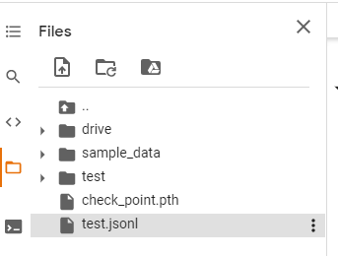
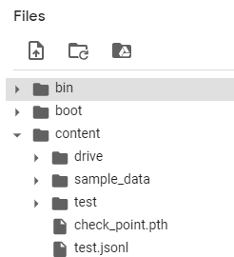
Run the Code Test
Steps: Tutorial available at https://drive.google.com/file/d/1aa75KqPg4qnEJ5HYpZrW51ETR_UA0IDN/view?usp=sharing
Open Colab notebook ‘RoBERTa_Model_Test’ at the below link:
https://colab.research.google.com/drive/1S9g8dD7JmuT6JsJo1ysAa4e3nTCNakxk?usp=sharing
Also uploaded to GitHub Repo
GitHub Repo path: https://github.com/Wenfan1993/CourseProject
Load the below items from the GitHub Repo to Colab environment at ‘\Content\’
test.jsonl (Uploaded to GitHub Repo)
https://github.com/Wenfan1993/CourseProject/tree/main/Test_Source_Data
check_point.pth (the checkpoint where we stored our trained model)
https://drive.google.com/file/d/1z1IIeU1e7DgqtAyyPWE66QyAG7h1D-sT/view?usp=sharing
Run the Colab notebook
The output ‘Answer.txt’ will be output and stored at Collab ‘\Content\’

Slide 12
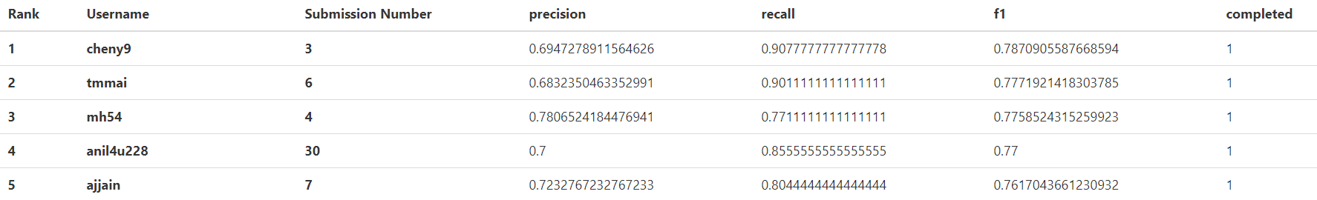
Our Results
We passed the base-line!
As of 12/11, 11:00PM CST, we ranked No.5 at the leaderboard,
We achieved precision 72.3%, recall 80.4% and f1 76.2%.
We are here

Slide 13
Appendix
References:
(1) https://huggingface.co/roberta-base
(2) RoBERTa: A Robustly Optimized BERT Pretraining Approach, by Linhan Liu et. al.
https://arxiv.org/abs/1907.11692
GitHub Repo path:
https://github.com/Wenfan1993/CourseProject

Slide 14
Thank You!
For any question, please feel free to contact our team members:
Wenxi Fan
Email: wenfan1993@gmail.com/Wenxif2@illinois.edu
Abhishek Jain
Email:aj26@illinois.edu

